Slide 2
REMUS RealTime Evolution : KAFKA 08.03.2019
HSE-CEN-CO Section
Alexandru Savulescu on behalf of REMUS TEAM

Slide 3
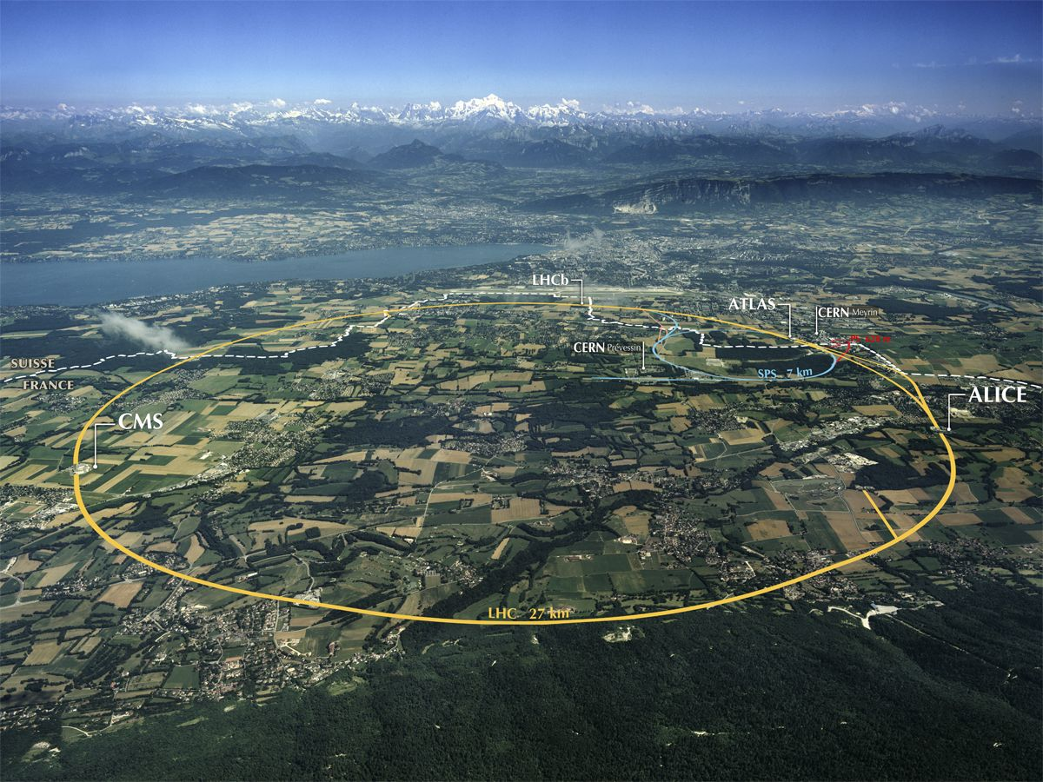
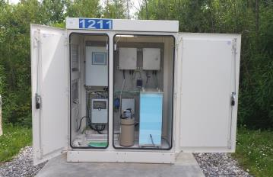
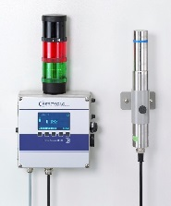
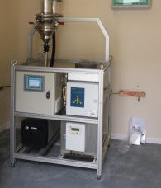
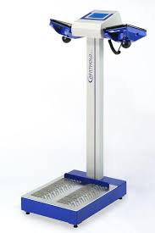
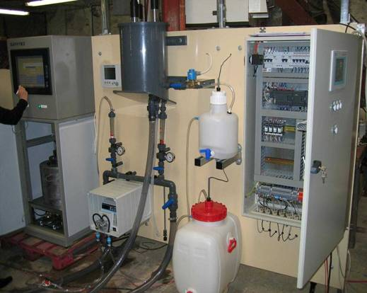
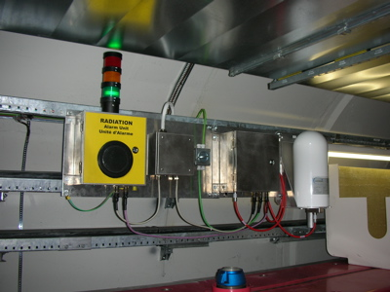
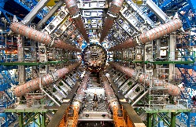
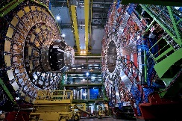
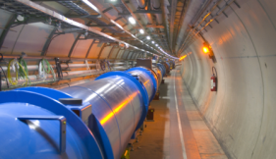
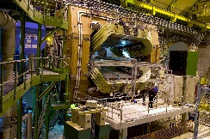
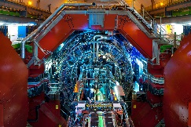
Radiation Protection and Environment Monitoring at CERN (Context)
Environment Monitoring:
50 km Accelerator Tunnel - 60 Access Points - 160 Experiments - 8,000 Radiation Workers
Radiation Protection:
~500 Monitoring Stations:
24 different types
Commercial Off-the-Shelf & Internally Developed Stations
Surface and Underground areas
~3,200 Measurement Channels:
1,000 measurements archived / second
Workplace and Environment Safety
Reporting to authorities:
- Nature and quantities of emitted ionizing radiation
- Conventional environmental measured values
Stray Radiation (x43)
Gamma Radiation (x46)
Ventilation (x47)
Hand-Foot Contamination (x60)
Water (x14)
Radiation with Alarm Units (x100)
Many more!
ATLAS
CMS
LHC Tunnel
LHCb
ALICE
Many more!

Slide 4
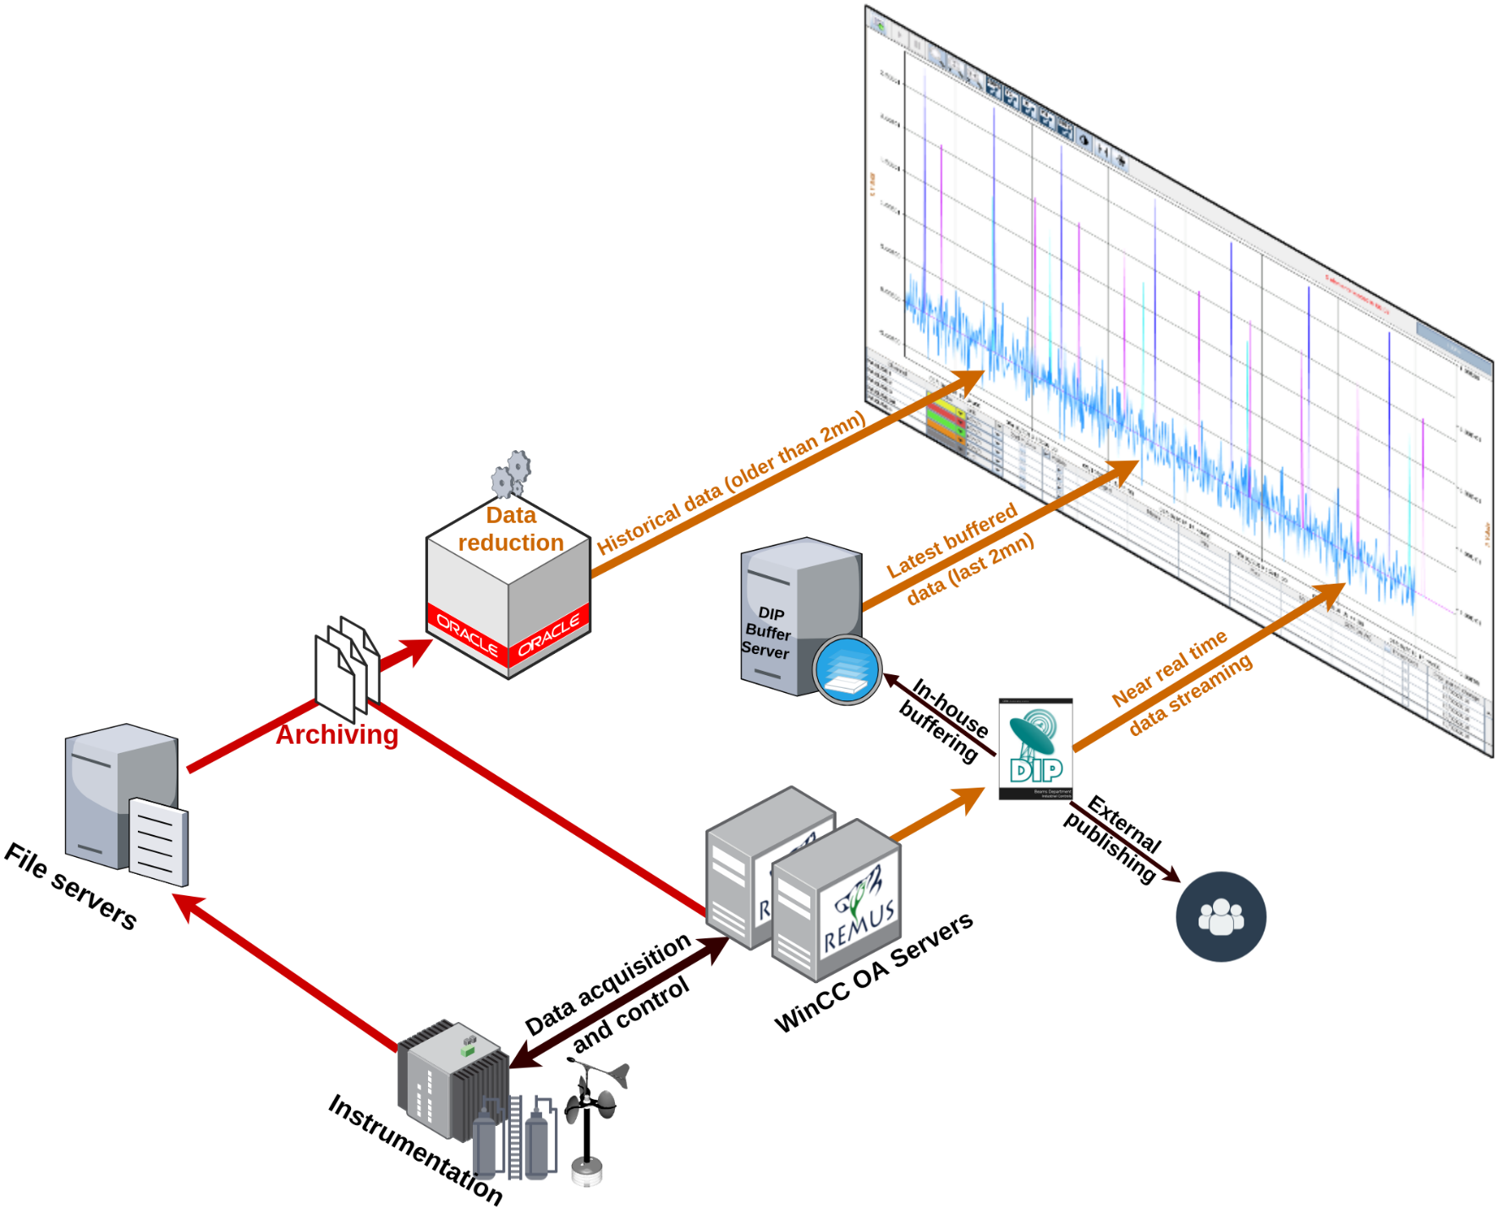




REMUS RealTime Visualization - DIP
CCC & Other control rooms
Issues
Synchronous
No ACLs
Single Point of Failure
Issues
DIP WinCC OA driver not 100% redundant compatible
High maintenance

Slide 5
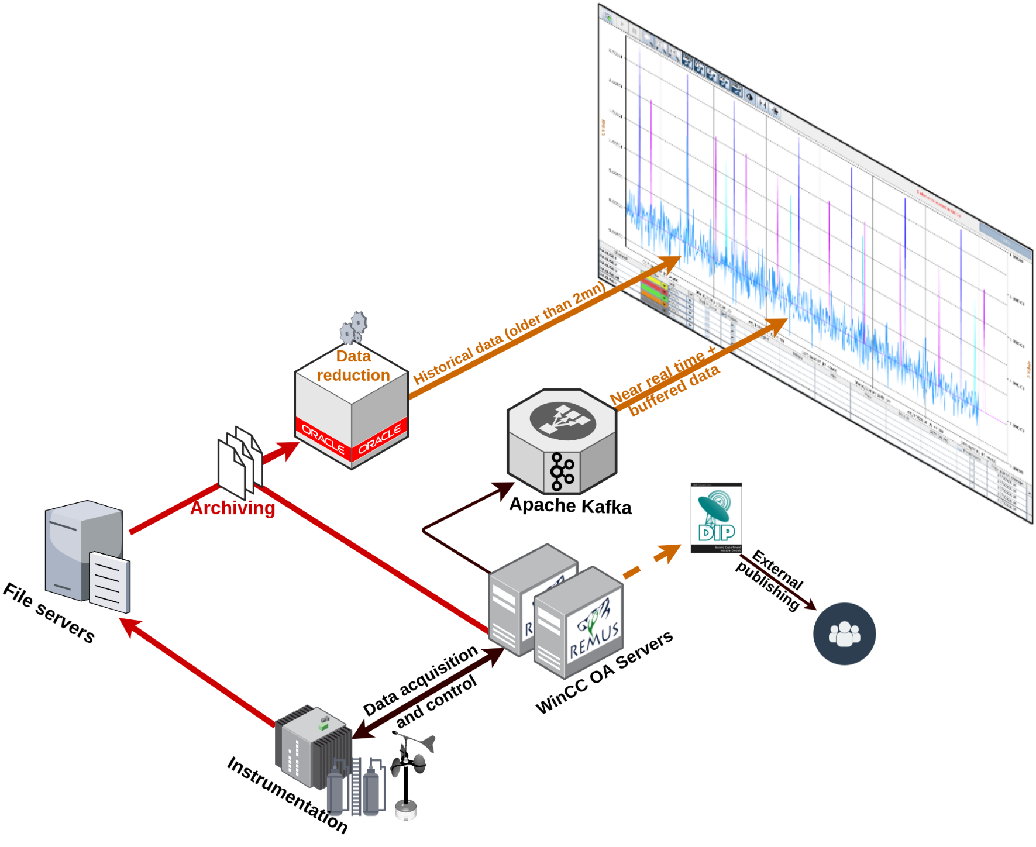
REMUS RealTime Visualization - KAFKA
CCC & Other control rooms
ATLAS, CMS, TI, ???
Added value
DIP is not a SPOF for RT
DIP Buffer Server is gone
Asynchronous data streams

Slide 6
WinCC OA KAFKA Streaming
In-house WinCC OA Kafka driver
WinCC OA driver API
librdkafka + cppkafka
One REMUS KAFKA publisher
Actually two ☺
REMUS is a redundant system, only one publisher is active at a time
REMUS data streams
Unique measurement as JSON
REMUS JSON format
{"id":<STREAM ID>,"value":<VAL>, "timestamp":<TS>, "unit":<UNIT>, "flags":{<FLAGS>}}
KAFKA key: <STREAM ID>
Built from one or more source DPEs
Other streams in the near future (parametrizations, events, etc.)
Can be any string or data format

Slide 7
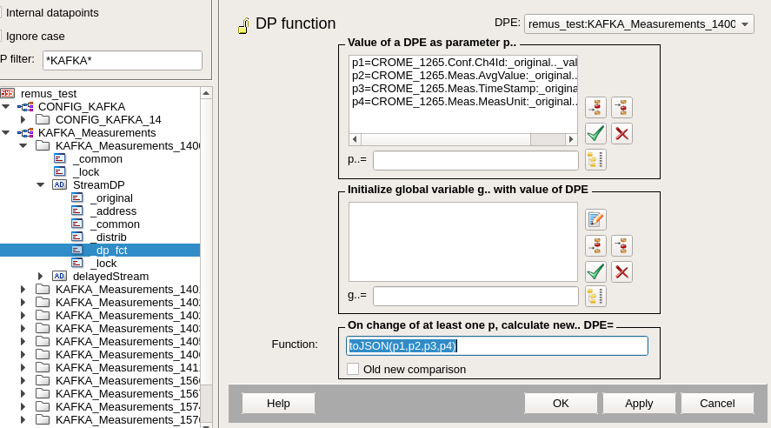
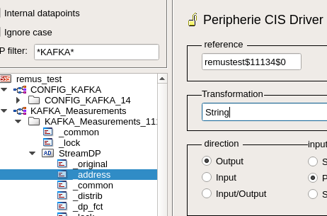
KAFKA Streaming – WinCC OA: REMUS Implementation
Dedicated DPs for streaming
Isolated from the device model DPs
Generically addressed with the WinCC OA Kafka driver
KAFKA TOPIC$KAFKA KEY$DEBOUNCINGTIME
Ex: remustest$11134$0
Debouncing mechanism
Allows data streams built from unsynchronized DPEs to stream exactly once
Implemented in the WinCC OA Kafka driver
Debouncing time period sent to the driver for each stream
DEBOUNCINGTIME = 0 ➔direct streaming with no debouncing

Slide 8


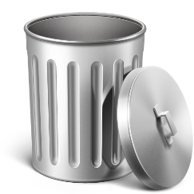
KAFKA Streaming – WinCC OA debouncing example
Example: value DPE updated 20ms after timestamp DPE
Initial DPEs values: {ID, T0, V0, UNIT}
1st change: timestamp T1 @0ms
2nd change: value V1 @20ms
{ID,T1,V1,UNIT}
{ID,T1,V0,UNIT}
Period start →
{ID,T1,V0,UNIT}
{ID,T1,V1,UNIT}
← Period end
DEBOUNCING TIME PERIOD 30ms

Slide 9
Next steps
Imminent deployment in PROD (Update 09.04.2019 : 100% completed ;-)
All RealTime measurements
Already test-streaming ~40% as we speak ☺
WinCC OA data exploitation via web & mobile applications
Discuss with (known) REMUS external DIP subscribers about Kafka adoption
ATLAS
CMS
TI (C2MON)
WinCC OA data ingestion via Kafka driver (Update 09.04.2019 : completed)
Measurements, events, etc. from new devices (i.e. IOT)
Link DPEs, in real time, with ACLs, between several WinCC OA systems!

Slide 10
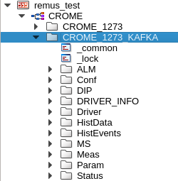
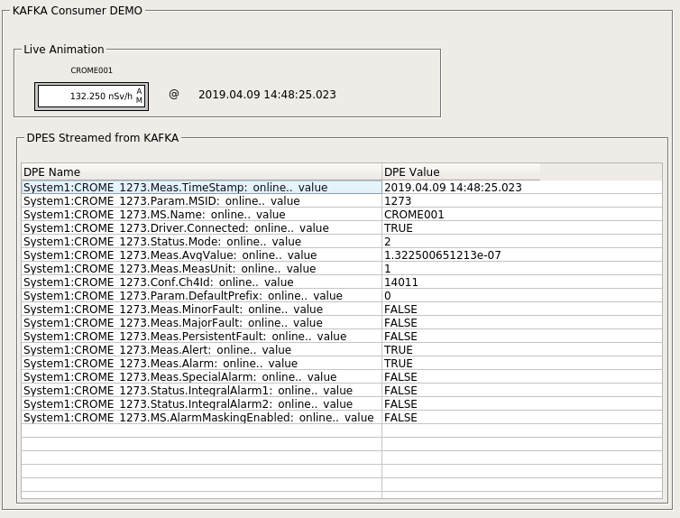
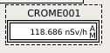
KAFKA – WinCC OA Data Ingestion (slide added on 09.04.2019)
The KAFKA WinCC OA driver can subscribe to topics and ingest data:
Generically addressed with the WinCC OA Kafka driver
KAFKA TOPIC$KAFKA KEY
Ex: remustest_demo$CROME_1273.Meas.AvgValue
Example practical application: link two WinCCOA SCADA Systems
Stream from `remus_test` system
to `remustest_demo` topic
Ingest into `System1` from
`remustest_demo` topic
e-group ACLs
Try out this demo WinCC KAFKA consumer application:
kafka-consumer-demo on gitlab

Slide 11
Key takeaways
Use of Kafka for REMUS RealTime streaming
Tie off DIP dependencies
Open the door for new solutions
Generic WinCC OA Kafka driver
Stream and ingest any WinCC OA DPs to the IT infrastructure
Debouncing mechanism for streaming to cope with WinCC OA design if needed
Small code base: https://gitlab.cern.ch/hse-see-co/WCCDrivers/kafka
Kafka clusters available from GPN and TN
Thank you IT-DB !
Open for collaborative development and promotion of KAFKA CERN-wise

Slide 12
Q&A

Slide 14
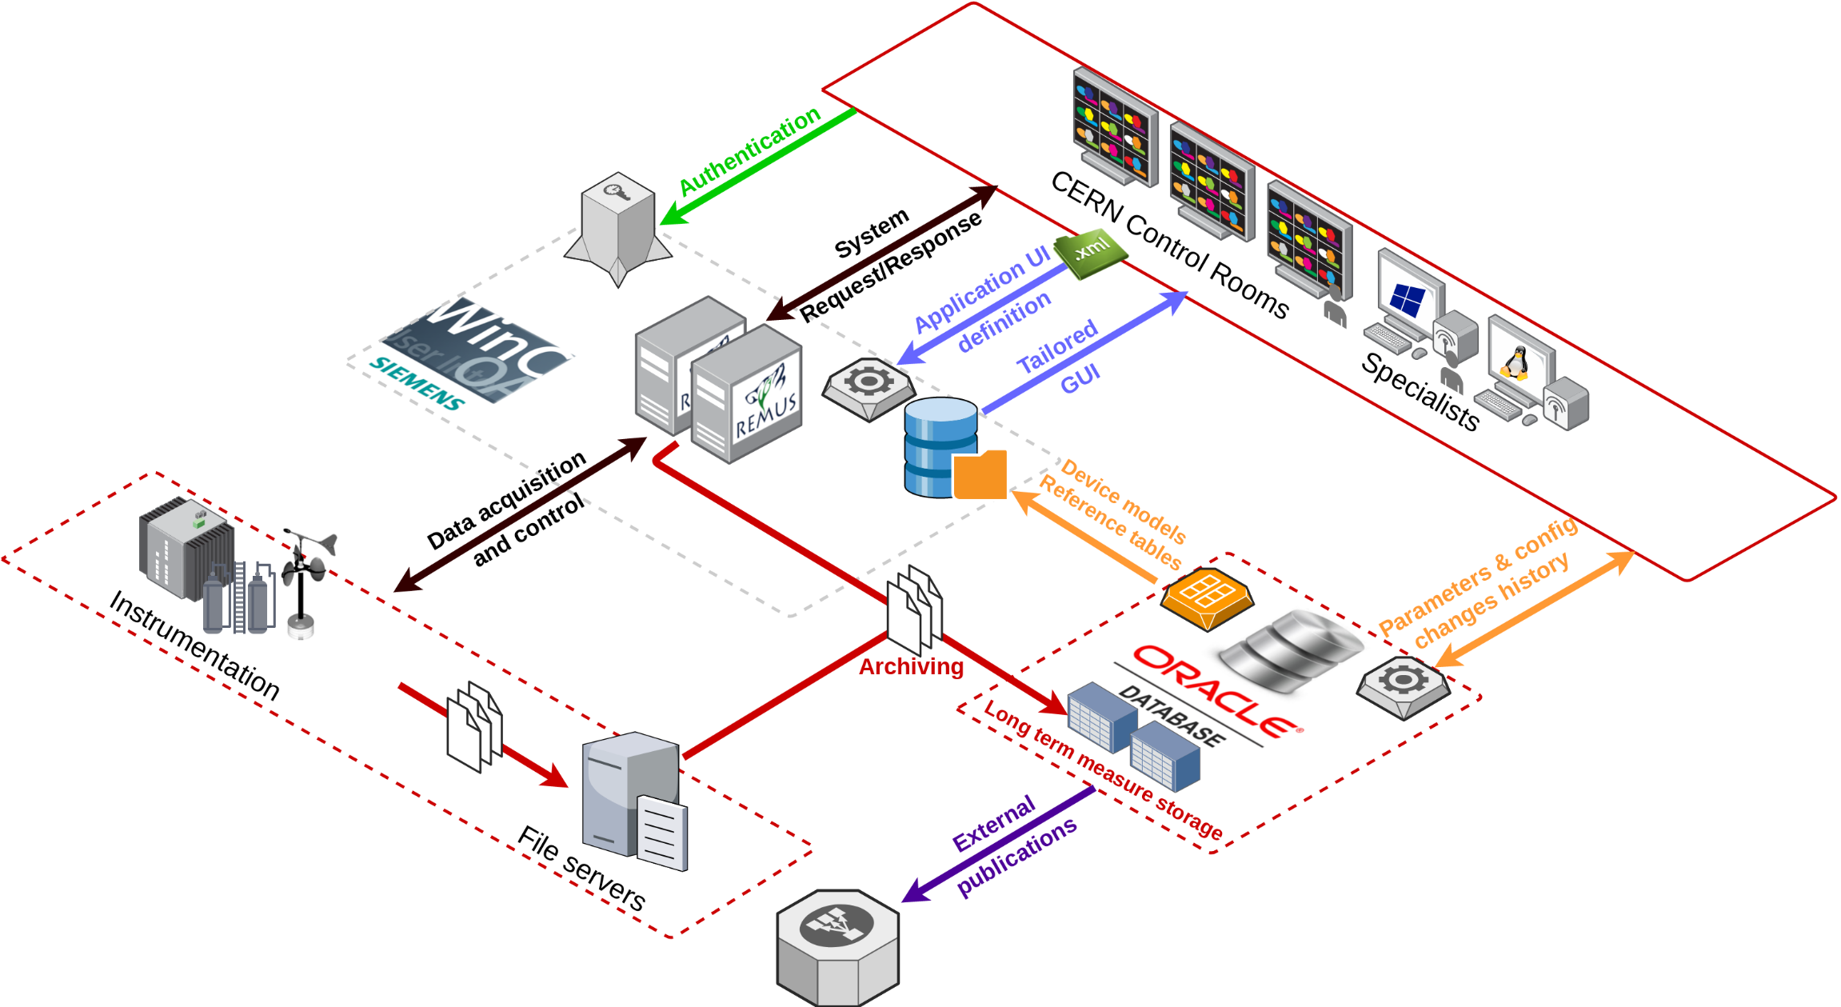
REMUS Architecture

Slide 15
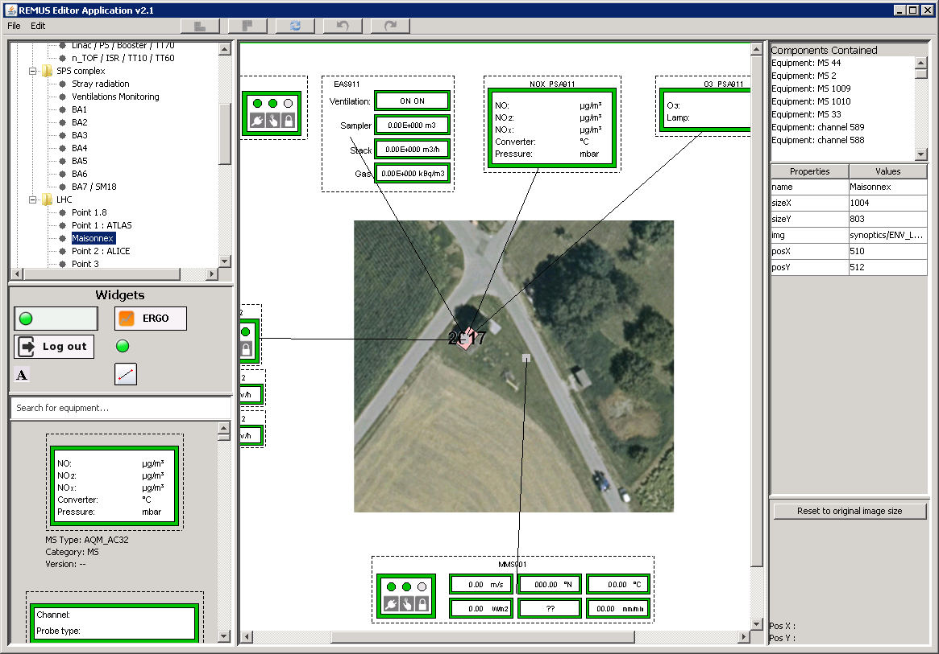
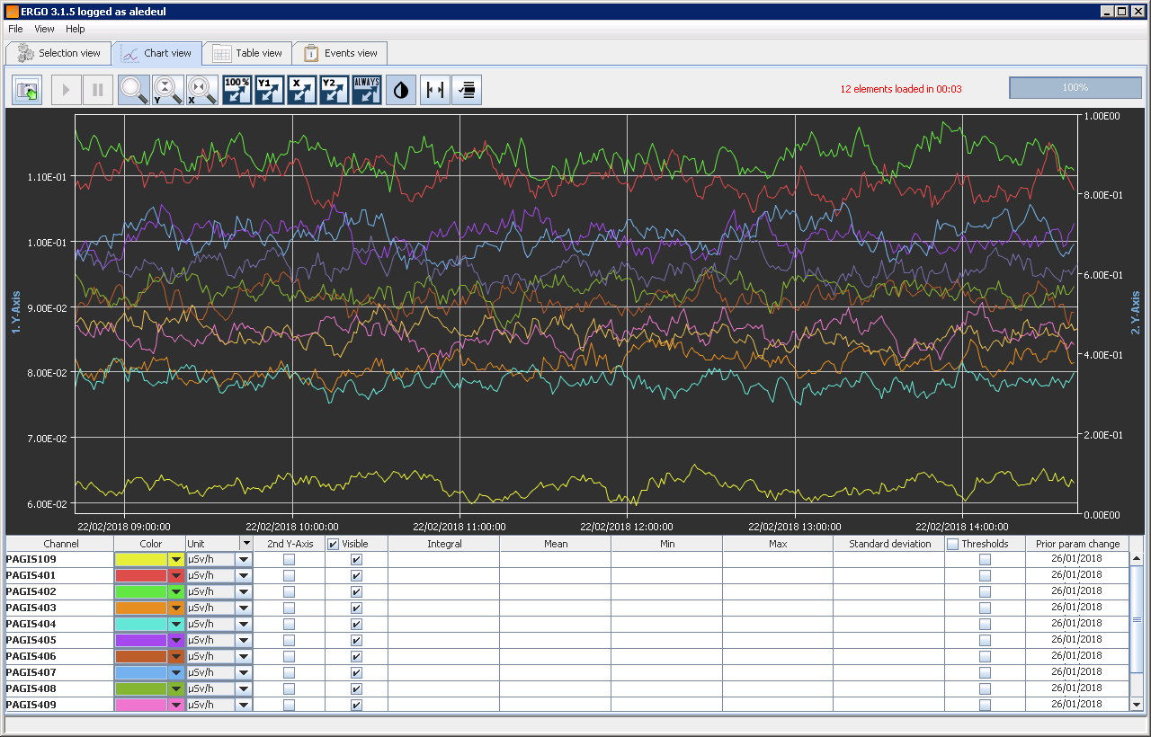
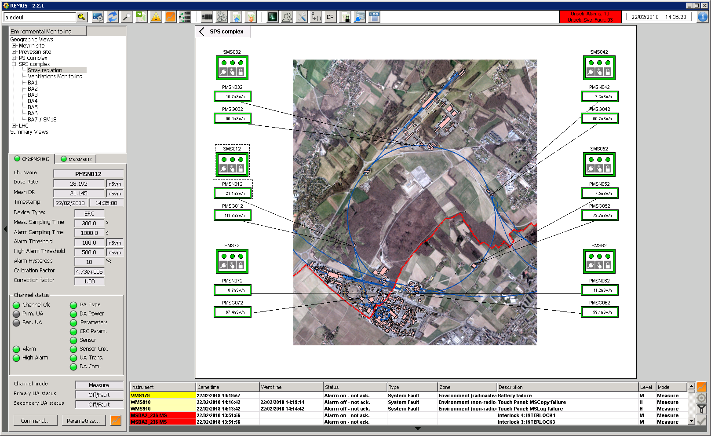


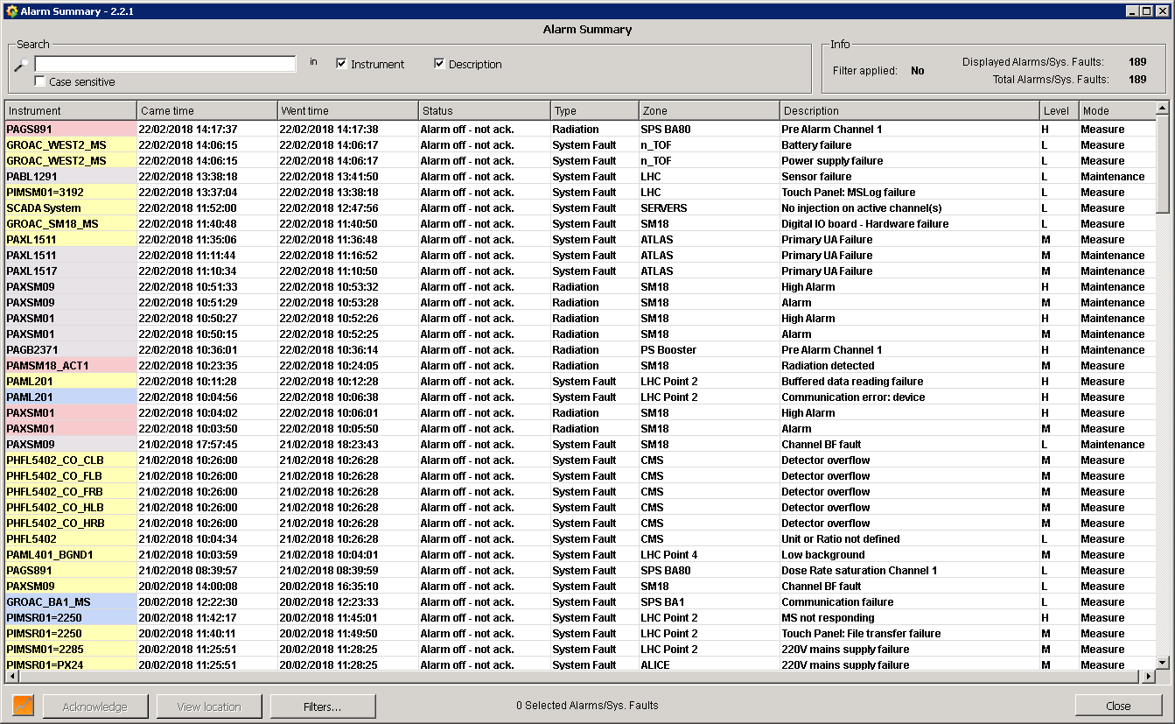
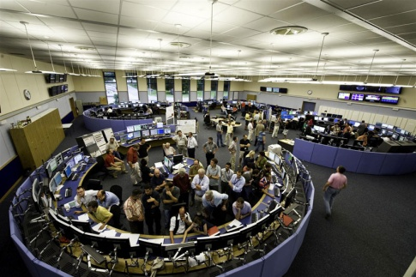
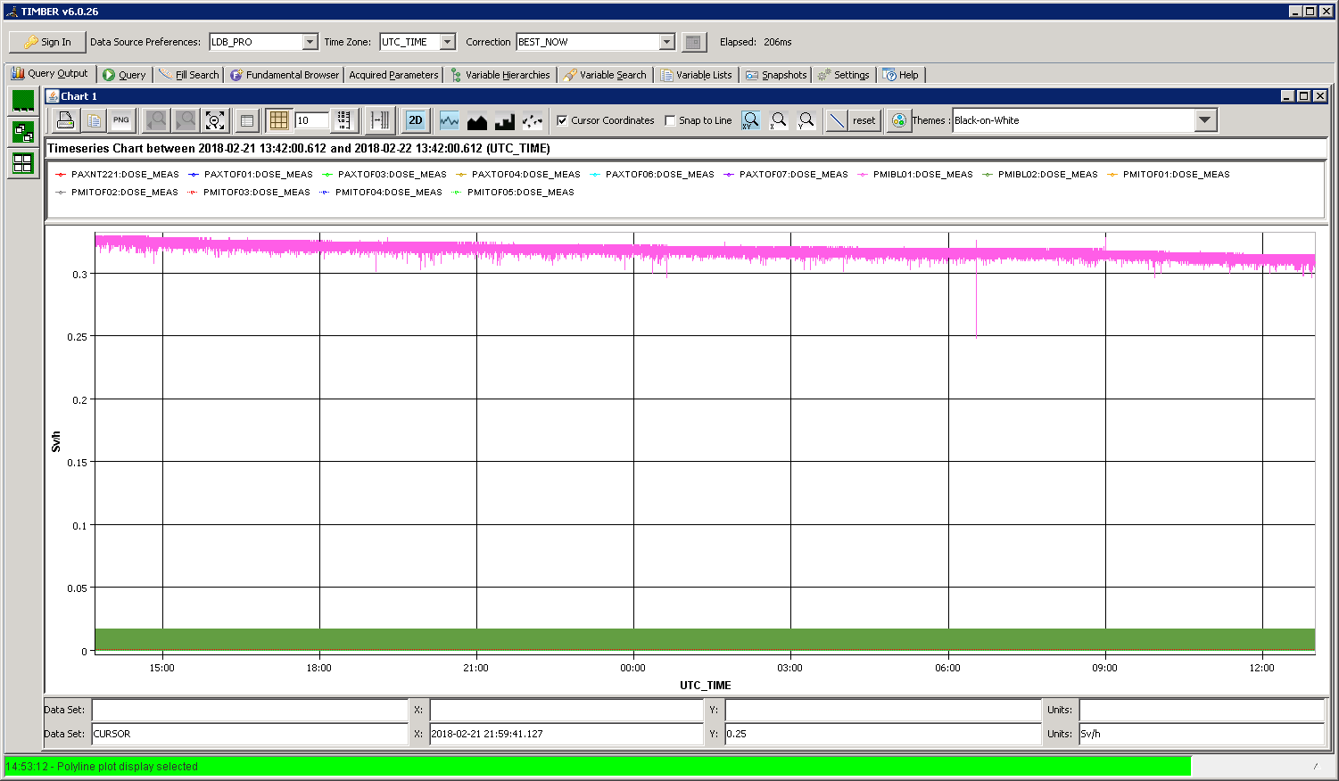
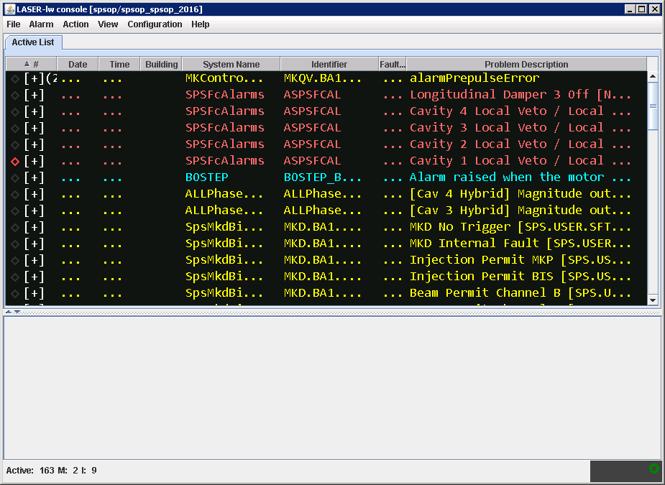
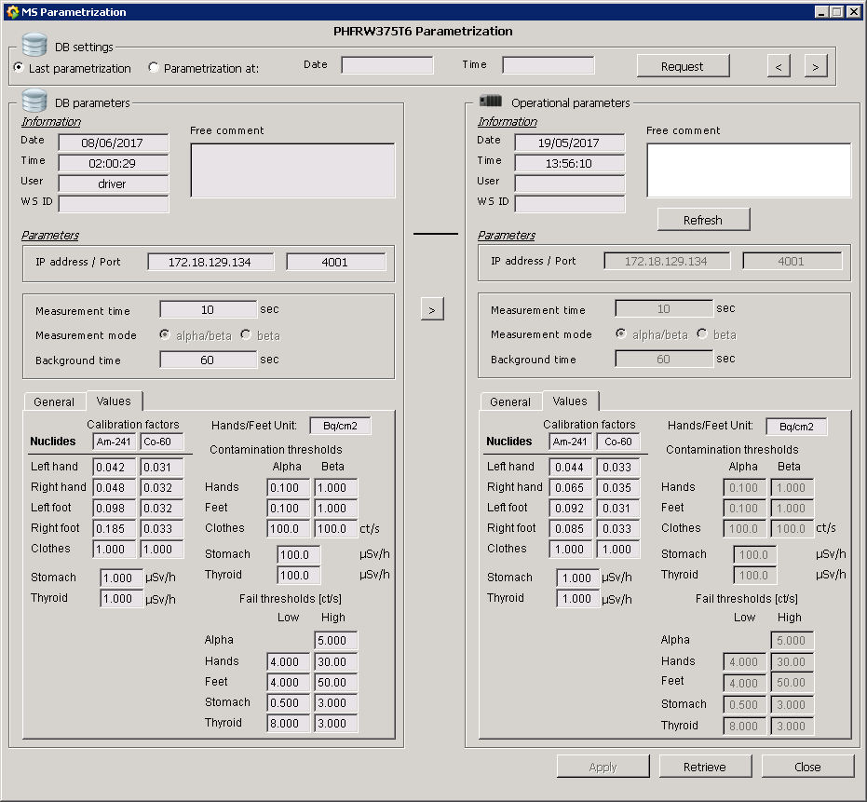
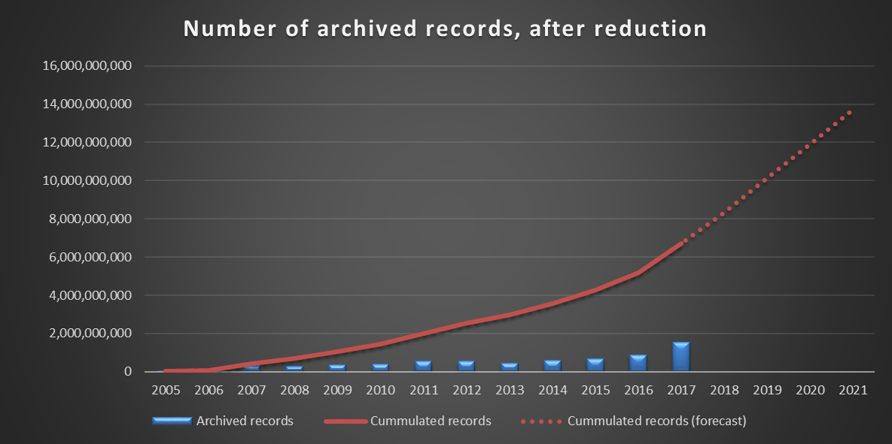
REMUS – Main Functionalities
GUI Editor
Data Visualization
Application Editor
Supervision
18 Applications
Control
Data Acquisition
Supervision
8Bn Meas.
Client
626 Synoptic
600K
Data Points
24
Station Types
Data Exchange
Alarm Screen
LASER DIP Meas. DB
3 200
Channels
500
Stations
Client
82K Alarms defined
Data Archiving
Online
Control/Command
38Bn Meas./year 2Bn after reduction
1 000
Meas./sec
Client
46k parameters
REMUS Functional Diagram

